Slide 1

ZoroMine
A quantum leap into crypto mining
Sarvesh Prabhu, Arjun Janakiraman, Jai Trivedi: Lambert High School

Slide 2
Technical Brief
Quantum-powered cloud-based algorithm hosted on Amazon Web Services:
AWS
Amazon Graviton 3.0 Processor
Amazon Quantum Computing
Machine Learning
ZoroMine saves electricity by 875% and ushers in the new age of young investors through its cost effective, and sustainable form of crypto-mining.

Slide 3
Financial Model
$49 USD Monthly subscription fee
Standard number of threads and processing power
Branch out to premium tiers with higher threads and power (Tier II $69, Tier III $99)
Guaranteed profit with cash-back if no profit, safe for young investors
Financial Advisement
Assure every customer at ZoroMine makes educated investment choices
ZoroMine’s consultant partners will set up an investment plan for both crypto investment and mining

Slide 4
SBA 7(a) Loan Use

Slide 5
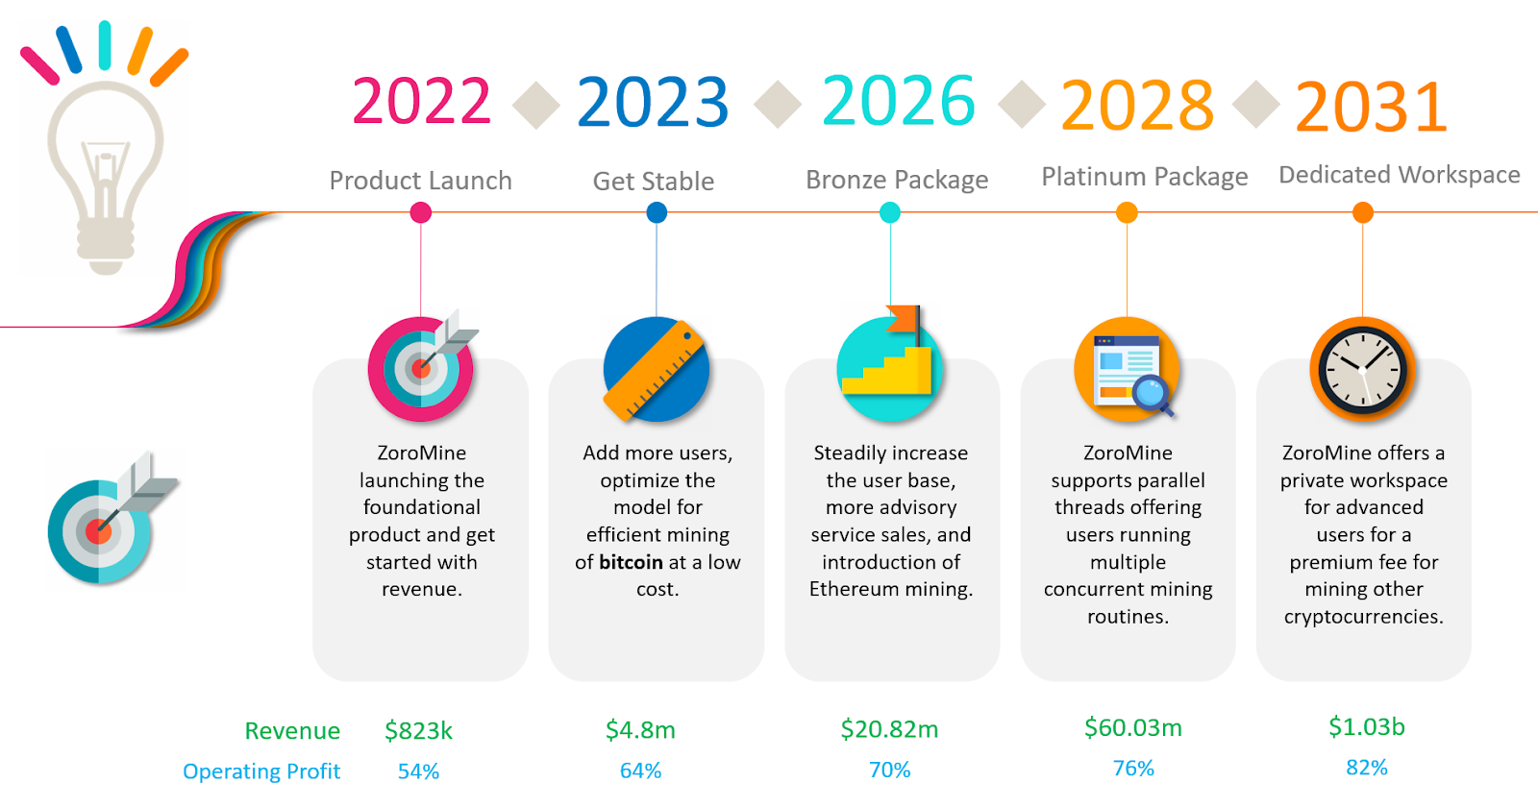
Financial Stability Forecast

Slide 6
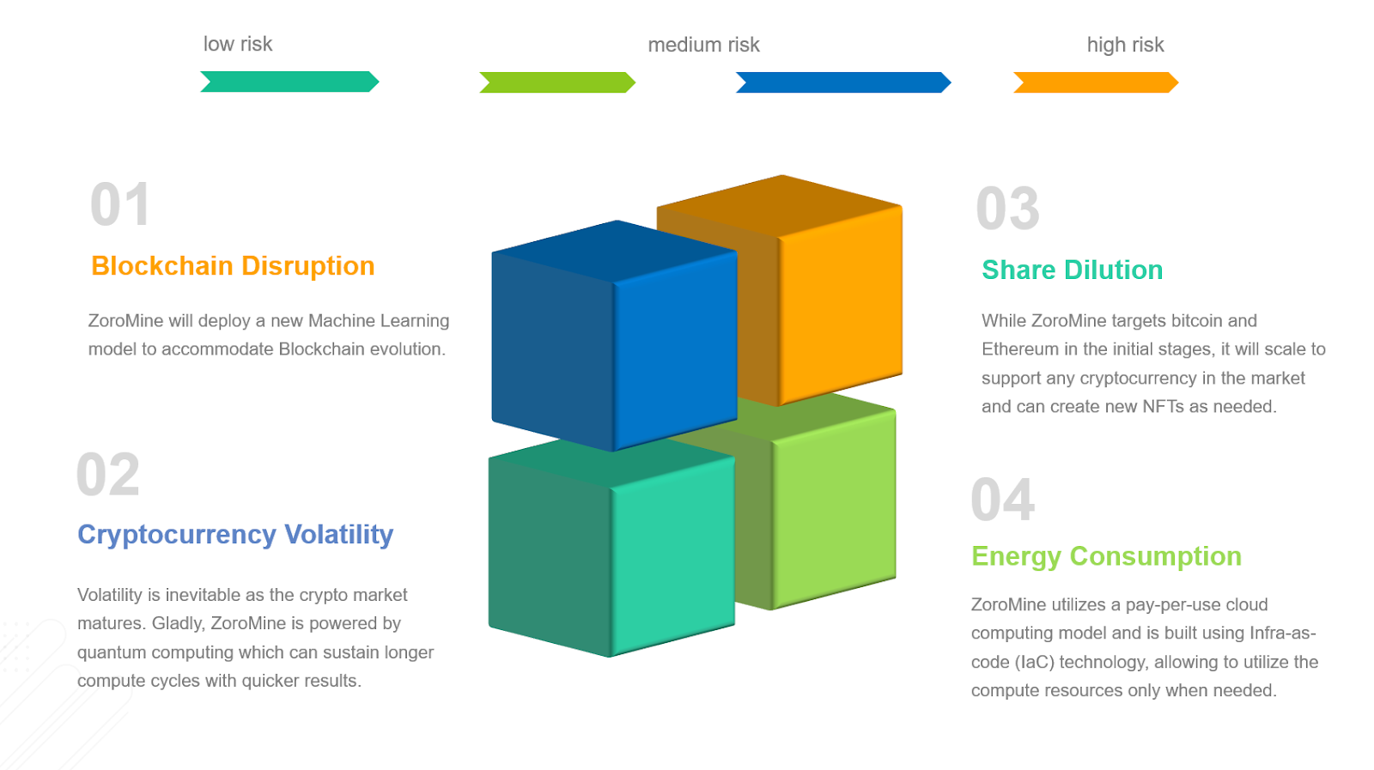
Risk Analysis

Slide 7
Thank you!

